Slide 1
Labour mobility trends, demographic change & skill shortages
Alberto Posso
Workshop on Strategy of Human Rights in APEC
July 7, 2019
Chinese Taipei

Slide 2
Synopsis of problem
In many economies, the working population will decline significantly in the next few years.
Additionally, changes in technology will alter demand for various types of work.
Increasing demand for some (skilled?) and decreasing it for others (unskilled?).
Labour mobility is a potential solution to meet labour supply shortages.
Changes in demand will need to be addressed with other policies.
If so, we will need to understand which ones.

Slide 3
Source: StatsAPEC (2019).
Population, Ages 15-64 (% of total population)

Slide 4
Percentage of world working age pop., 2050
Source: UN Population Division (2015).
Note: LDR refers to Least Developed Regions.

Slide 5
Ageing society effects
Ageing society:
Less workers.
Upward pressure on wages.
(Potential) foreign workers observe wage differential and decide to move (neoclassical economic model).
Young people will predominantly be in Africa & India in 2050.

Slide 6
Technological change
Technological change (automation) is likely to lead to changes in labour demand.
Some jobs within some industries will become redundant.
New jobs will also be created.
Skill composition of demand is uncertain.
Big debate in the academic literature.

Slide 7
Susceptibility to Automation, by industry (%)
Source: Frey, C. B., & Osborne, M. A. (2017). The future of employment: how susceptible are jobs to computerisation?. Technological forecasting and social change, 114, 254-280.

Slide 8
Labour mobility
For foreign workers to fill the gaps, the ‘right’ type of workers must arrive.
They should be young to meet labour supply shortages created by an aging population.
The ‘right’ level of skill-intensity of foreign workers is uncertain.
It is likely to vary both within and between industries.

Slide 9
Global migration trends
Accurate & comparable data on international migration are limited.
Lack of availability, comparability and frequency of data.

Slide 10
But data is getting better…
SDGs recognise migration as integral to development.
Push for economies around the world to collect timely & comparable data.
IOM set up a Global Migration Data Portal.
The beginning of evidence-based policies for sustainable mobility.

Slide 11
So what does mobility look like?

Slide 12
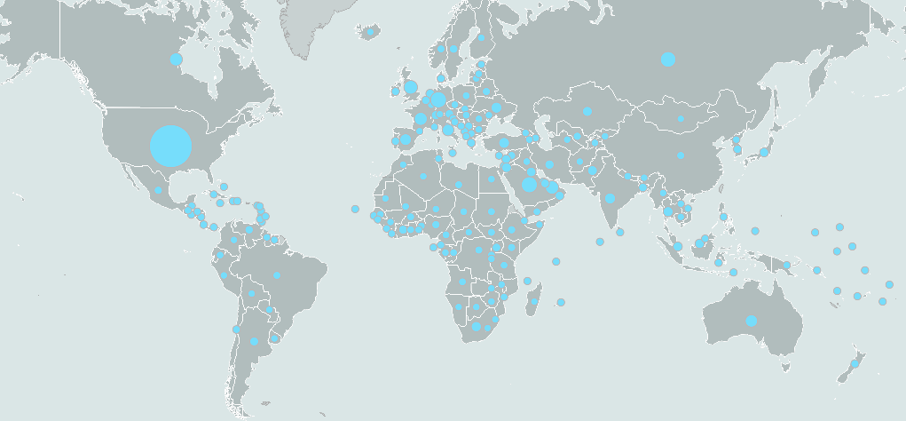
Total number of international migrants

Slide 13
Migration Trends
Migrant stock:
2017: ~258 million.
2000: ~173 million.
1980: ~102 million.
Proportionally:
2017: 3.4%.
2000: 2.8%.
1980: 2.3%.

Slide 14
Labour mobility trends
Latest estimates are from 2013 (ILO).
~150 million foreign workers globally in 2013.
~66% of all migrants are workers.
~11 million (7% of foreign workers) are domestic workers.

Slide 15
Demographics of foreign workers
Women: ~67 million (44%).
Men: ~84 million (56%)
Age:
One in eight is between 15-24 years-old.
Median age is 39.

Slide 16
Location
~50% of all foreign workers are located in North America and Northern, Southern and Western Europe.
~12% are in Arab States.
~40% of all migrant workers are located in developing countries.

Slide 17
And the skill composition of foreign workers?

Slide 18
Skill composition
Data on skill composition are difficult to obtain.
Focus foreign workers in the United States.
The data come from the 2010 American Community Survey (US Census Bureau).
The 2010 American Community Survey employed a single long form questionnaire completed by one of 100 households and group quarters.
Data includes information from 339,800 foreign workers.

Slide 19
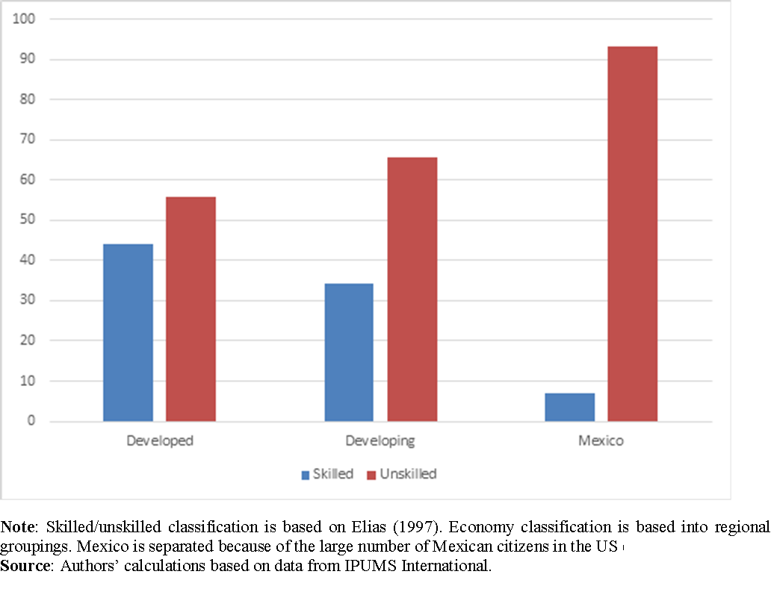
Percentage of skilled and unskilled foreign workers by level of economic development of origin region/economy, 2010

Slide 20
Piecing this together
Foreign workers are:
Relatively unskilled (may be different for other developed countries).
Male.
39 years of age.

Slide 21
What does the ‘right’ foreign worker look like?

Slide 22
To answer this we need:
Longitudinal data to compare characteristics of foreign & domestic workers.
Are they substitutes or compliments?
Does skill level matter? Is unskilled bad?
Longitudinal data is important because skill composition of tomorrow’s demand for labour is unknown & subject to change.

Slide 23
Can we create the ‘right’ worker after they arrive?

Slide 24
To answer this we need:
Information on the availability and characteristics of firm/industry specific, gov’t-funded or other adult training programs.
Longitudinal information on number & characteristics of foreign and domestic workers.
Study whether firms/industries with training programs outperform others.
If so….

Slide 25
Lifelong learning policies
Incentives for life-long learning:
Tax breaks/subsidies for firms to
undertake in-house staff retraining.
Apprenticeships.
Facilitating access to finance for educational purposes throughout a person’s life.
Facilitating support (financial and technical) for universities to provide micro-credits and other retraining opportunities.
Improving pathways and transitions between formal and non-formal learning and work over the life span.
Income support.
Language skills for migrants.
Reduce early school leaving (support for at-risk students).
Including migrant children!

Slide 26
Lifelong learning policies
We think that they’re a good idea, they probably are a good idea, but we should really test when and how they work best and when they don’t work before fully committing to them.

Slide 27
Thank you
Comments welcomed
(alberto.posso@rmit.edu.au)

